Slide 1

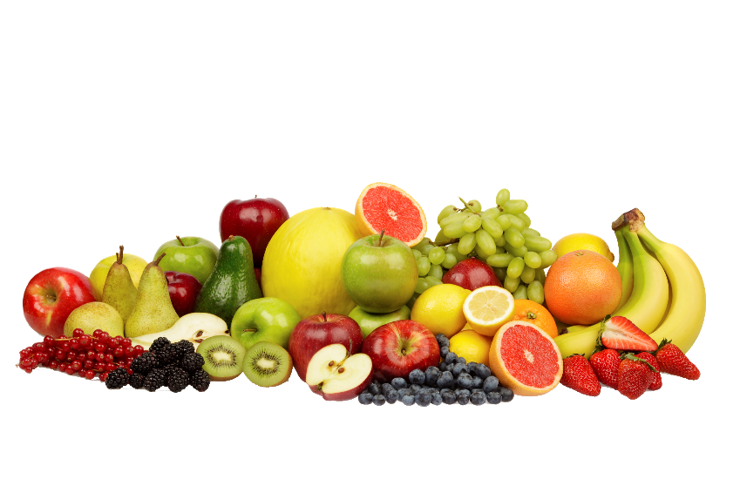
Institute of Advanced Research
Department of Computer Science and Engineering
OGANI - E-commerce Website
Mentor : Dr. Pankti Bhatt
Smeet Patel (IAR/12399)

Slide 2


WHERE PURITY MEETS PURPOSE

Slide 3

Introduction
OGANI is an e-commerce platform designed for seamless online shopping.
Built using Django, it provides a user-friendly shopping experience.
Features include product browsing, filtering, cart management, checkout, and secure payments.
Admin dashboard for managing products, orders, and users.

Slide 4



Problem Statement
Customers struggle with inefficient and outdated online shopping platforms.
Lack of seamless product filtering and checkout processes.
Admins face difficulty in managing products and orders efficiently.

Slide 5



Solution
OGANI provides an easy-to-use, modern e-commerce solution.
Features such as AJAX-based product filtering and a robust cart system enhance user experience.
The admin panel allows smooth management of products and orders.

Slide 6




Tech Stack Used
Frontend
Backend
Database
Other Tools
HTML/CSS
Python
MySQL
PlantUML
JavaScript
Django Framework
PostgreSQL
jQuery
AJAX
REST APIs
Bootstrap

Slide 7
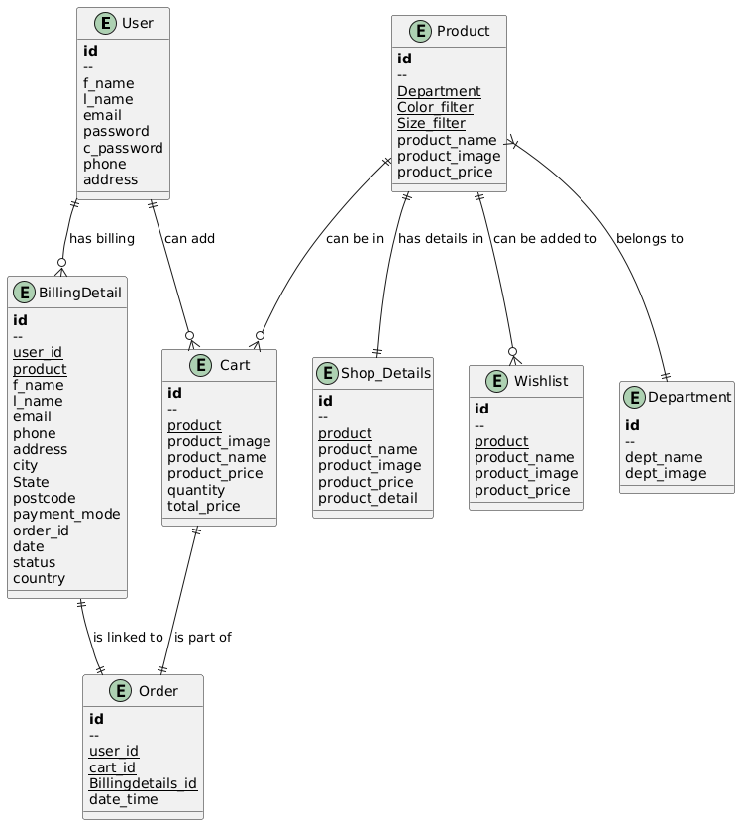
ER Diagram

Slide 8
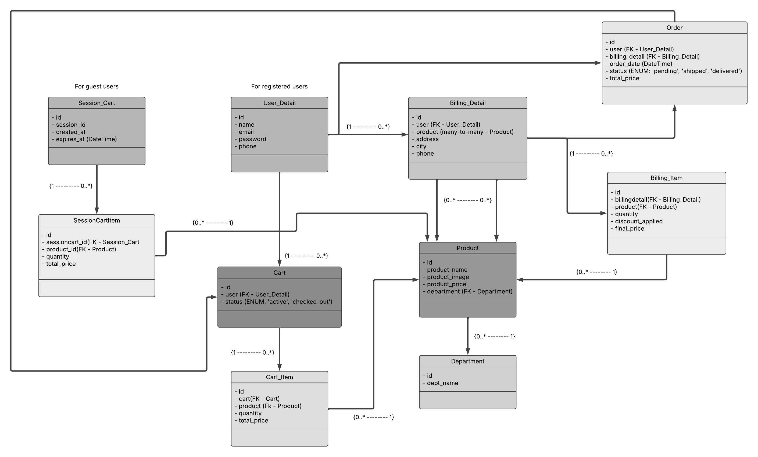
Class Diagram

Slide 9
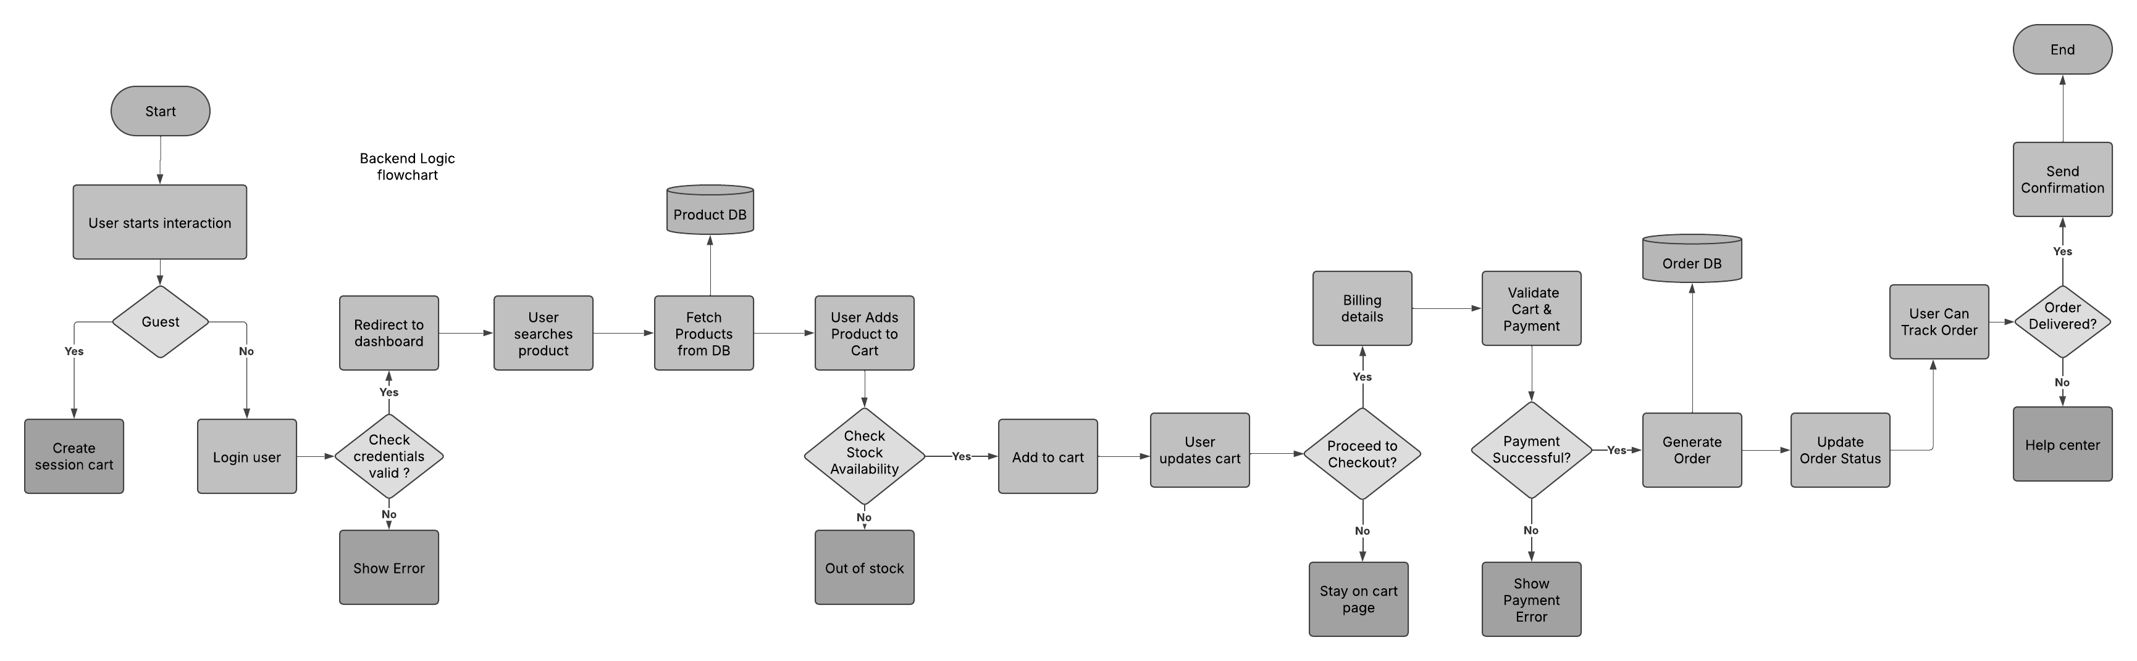

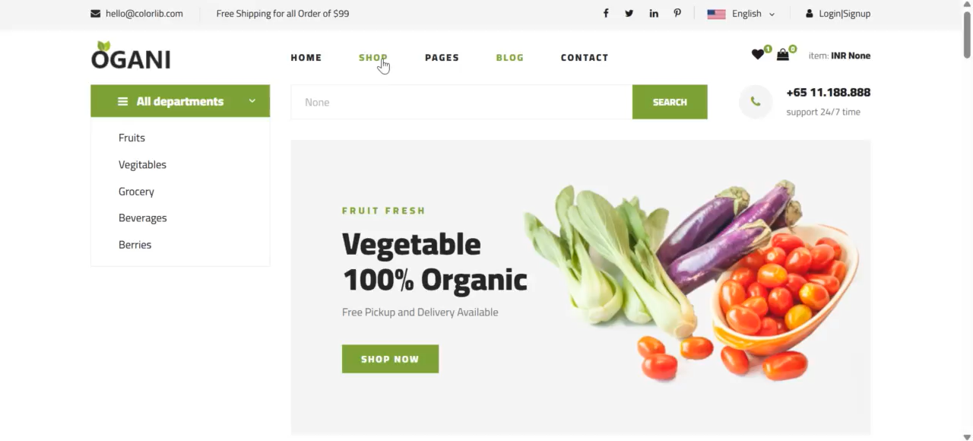
Back end logic flow

Slide 10
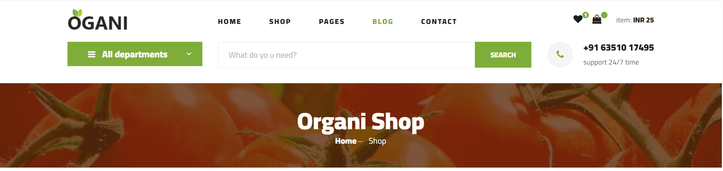
Features & Functionalities
Product Browsing & Filtering (AJAX-based for smooth experience).
User Registration & Authentication (Login, Logout, Secure Access)
Cart & Checkout System (Seamless shopping experience)
Admin Panel (Manage products, orders, payments)
Secure Payments (Integration with Payment Gateway)
Order Tracking & Management (For both users and admins)

Slide 11

Conclusion
OGANI provides a modern, efficient, and user-friendly e-commerce experience. Django-powered backend ensures scalability and security. The admin panel enhances business operations & product management.

Slide 12
Future Enhancements
AI-based product recommendations.
Advanced search & filtering with ML.
Multi-vendor marketplace integration.
Mobile app version for a better shopping experience.

